Slide 1
Campaign URL Validator
TMNA – RAPP

Slide 2

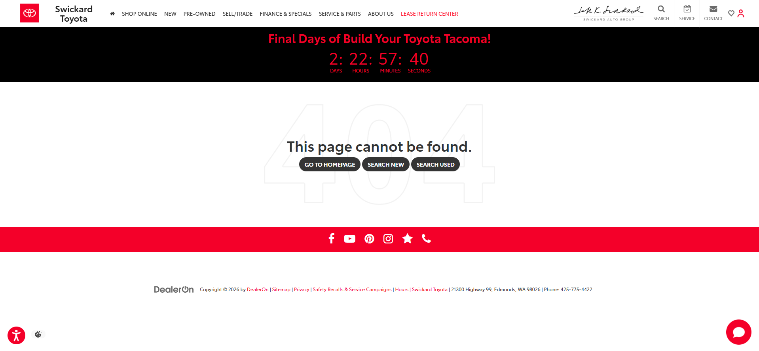

Problem statement
https://www.swickardtoyota.com/service-appointment/
Website URL may contain issues
404 Not Found
UTM parameters dropped on load
…
1268 Toyota dealer websites
Initial website URL issue identified & documented
Alternative URL proposed
https://www.swickardtoyota.com/service-center.html

Slide 3
Automated approach
Manual QA
1268 URLs
~1 week of manual check & documentation
Automated QA
1268 URLs
~2 hours of automated check & QA documentation auto-generated

Slide 4
workflow
Dataset
Streamlit UI
Validation Engine
Issue Classification
Recommended Fixes
QA Output File

Slide 5
Demo

Slide 6
FUTURE Enhancement
Priority 1
Homepage Scheduler Detection
Enhanced Page Load Error Classification (403 vs 404 vs 5xx)
Priority 2
Improve Suggested URL Confidence
Expand Scheduler Domain Library
Dashboard Reporting

